Slide 1

Why our company is not using the Scrum methodology?

Slide 2

Vision statement
Our vision is to make our company one of the best company in the Whole country. So, due to that reason we have to focus on reliable and efficient methods that will benefit our company and we can become popular in the market by following the latest and a new approach of software development.

Slide 3
Agile Method
Waterfall Method
In agile the tasks are divided to time boxes (small time frames) to deliver specific features for a release.
Iterative approach is taken and working software build is delivered after each iteration. Each build is incremental in terms of features; the final build holds all the features required by the customer.
Waterfall model — is a sequential development process that flows like a waterfall through all phases of a project (analysis, design, development, and testing, for example), with each phase completely wrapping up before the next phase begins.

Slide 4
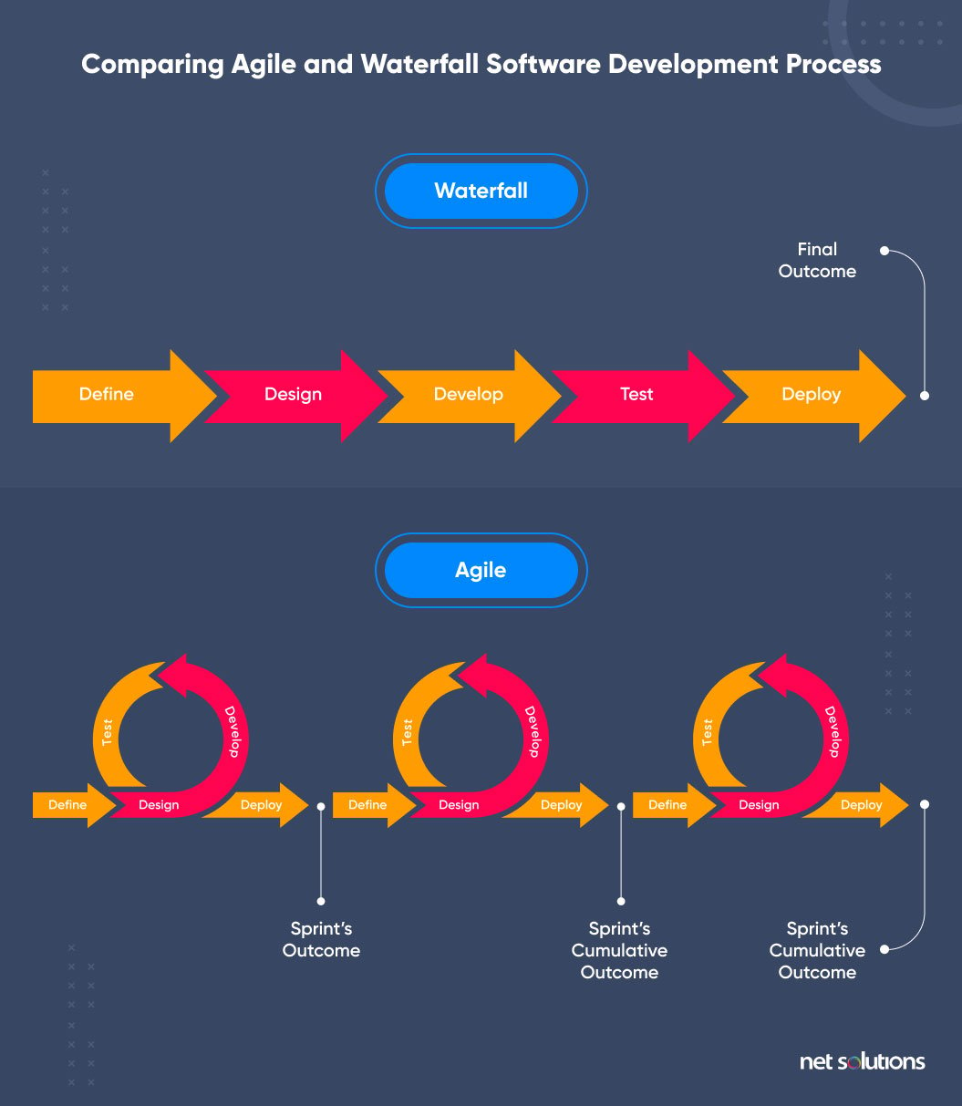

Slide 5
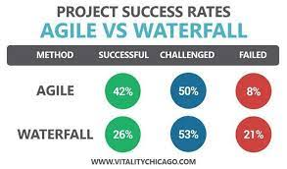
Market summary

Slide 6
Rewards of using Agile Method
Customer satisfaction by rapid, continuous delivery of useful software.
People and interactions are emphasized rather than process and tools.
Customers, developers and testers constantly interact with each other.
Working software is delivered frequently (weeks rather than months).
Face-to-face conversation is the best form of communication.
Close daily cooperation between businesspeople and developers.
Continuous attention to technical excellence and good design.
Regular adaptation to changing circumstances.
Even late changes in requirements are welcomed

Slide 7

Key issues with Waterfall model
It does not allow for much reflection or revision.
High amounts of risk and uncertainty.
Not a good model for complex and object-oriented projects.
Poor model for long and ongoing projects.
Not suitable for the projects where requirements are at a moderate to high risk of changing. So, risk and uncertainty is high with this process model.
It is difficult to measure progress within stages.

Slide 8
Scrum
Scrum is a framework of Agile.
With scrum, the product is built in a series of sprints (fixed-length iterations) that give teams a framework for shipping software on regular bases.
Milestones–i.e., the end of a sprint–come frequently, bringing with them a feeling of tangible progress with each cycle that focuses and energizes everyone.
Short iterations also reinforce the importance of good estimation and fast feedback from tests

Slide 9
Which Methodology we need to focus on
You can’t rely just on waterfall model only or to agile method only. It depends upon the requirements that which model you are trying to use. The main component in the project is requirement analysis which contributes almost 60-70% on the whole project and if there is an issue with requirements then you can’t use the waterfall model. So, you have to rely on Agile method because usually customers changes their requirements with time. So, if the project is lengthy then you need to go with the Agile method. If the project is small and you have clear requirements, then you can use waterfall model because it is good in this condition.
So, you can’t just stick to one method. You have to focus on booth methodologies so that it can benefit you and to your company.

Slide 10
Comments
According to the facts and figures we can work on Agile method, and it will be very helpful for us in the future.(Muhammad Anas)
I think we need to carry only in agile method because of its success rate.(Adeel Ahmad)
If we want to be successful in our field and in the market, then we need to work on both waterfall and agile method. Agile method also uses scrum and Milestones method which is very useful. (Aurangzeb Younus)

Slide 11
Thank you
Aqeel Ahmad
08-02-2023
Imaqeelahmad36@gmail.com

